Slide 1

Webtoon Analysis Samantha Andersen

Slide 2
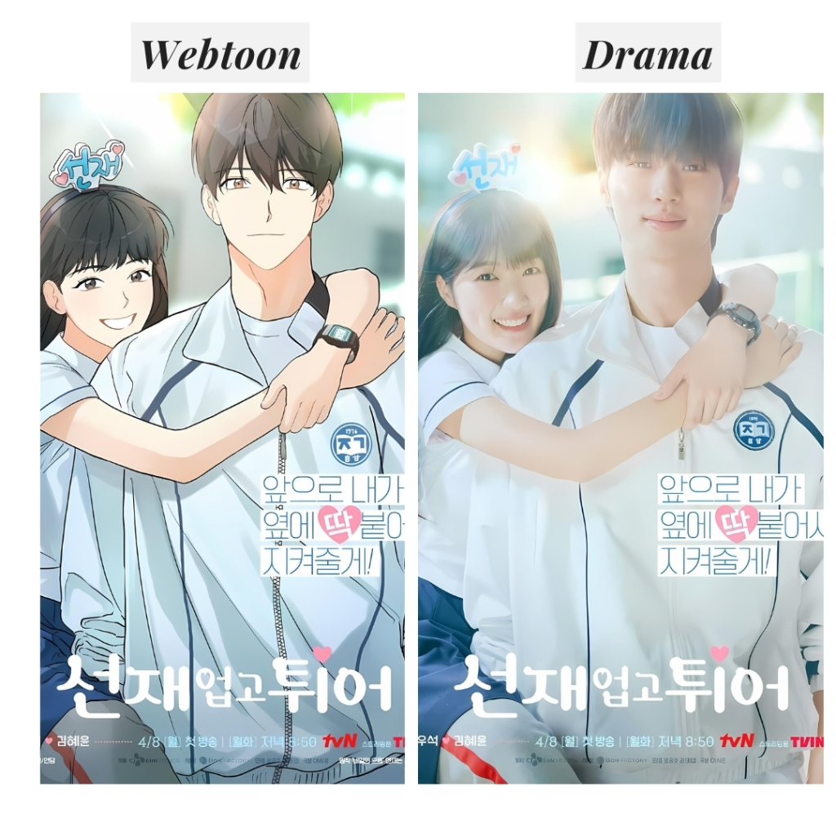

What Is a webtoon?
Line Webtoon is an app designed in South Korea as a form of entertainment where artists can create stories ((Like comics)) and upload them for people to read.
Webtoons have been popular in South Korea and other parts of East Asia for years and are becoming increasingly popular in the international market.
Some popular webtoons have even been turned into well known Korean Dramas which has increased Line Webtoon’s popularity in the West along with 한류 (the Korean Wave), AKA the rise in popularity of Korean entertainment worldwide.

Slide 3
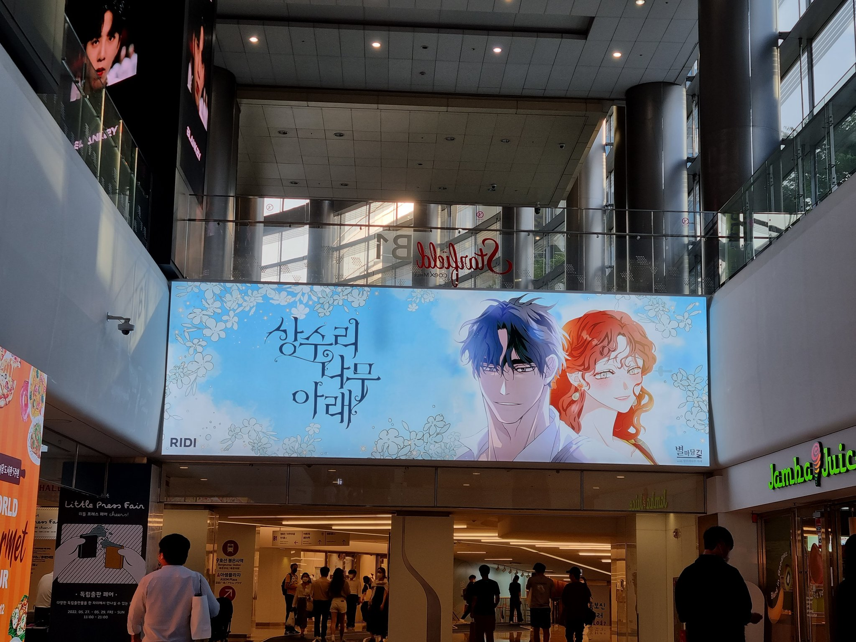

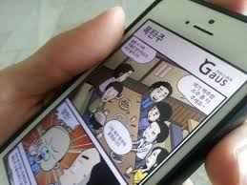
motivations
During my time living in Seoul, I would notice people on Webtoon everywhere I went (in class, on the subway, in the library, etc.)
Advertisements in malls and subway stations
More popular among students (elementary-college)

Slide 4
First step: Translation
The original CSV file consisted of 2100 variables that had columns of title, author, age, rating, description, and genre. All of these were entirely in Korean.
I translated these columns using my knowledge of the Korean language coupled with Google’s Cloud Translation API and created a new data set with added columns for the English translations

Slide 5
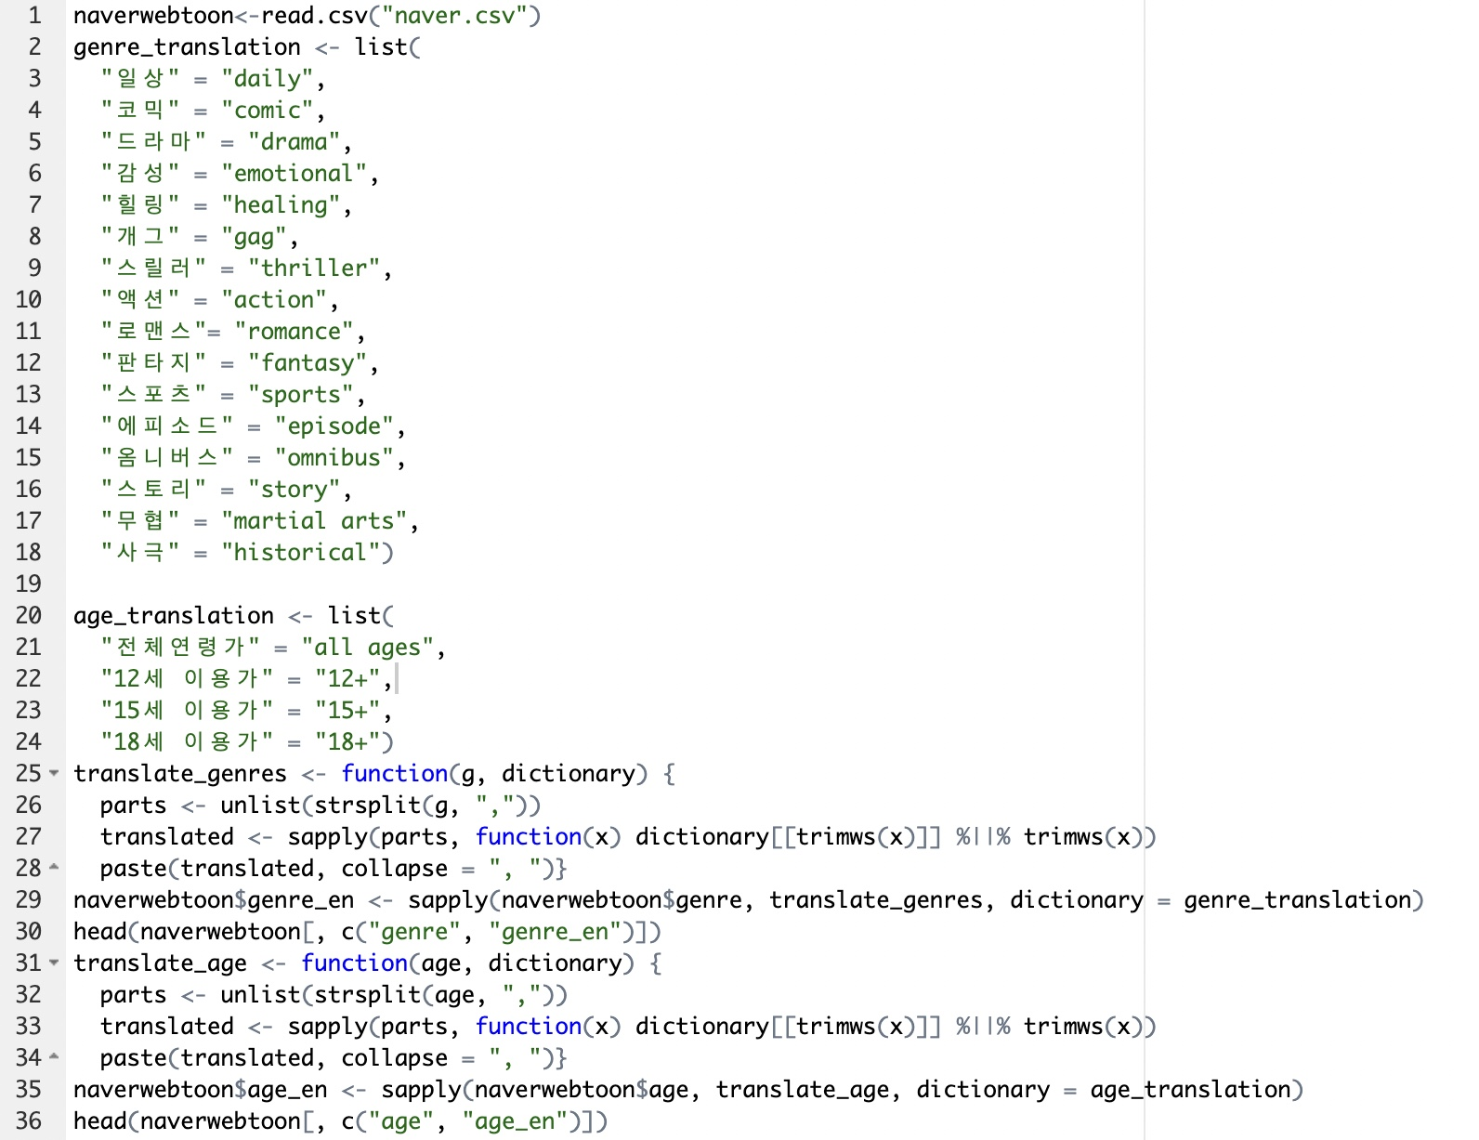
First, I hand translated both the genre and age columns using the list() function and created a dictionary for those.
I split them into their own separate columns titling them as “genre_en” and “age_en”

Slide 6
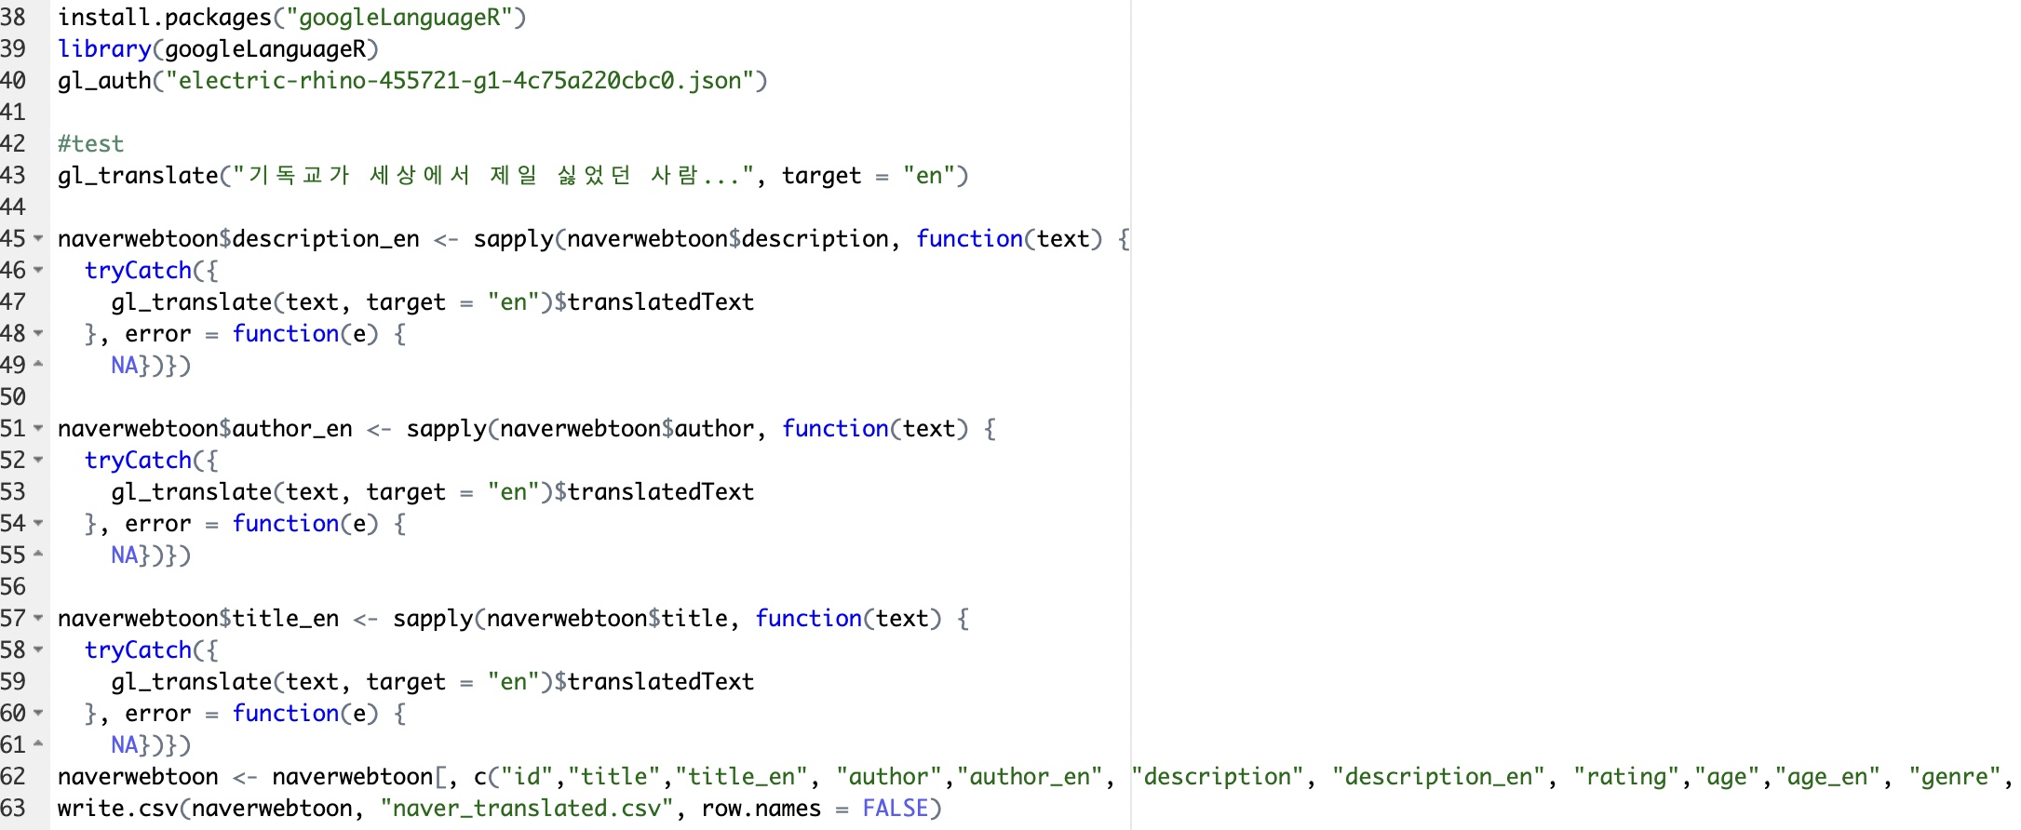
After researching how to use Google’s Cloud Translation API services, I was able to translate the Author, Title, Description easily
I created new English columns for those as well
Wrote a new CSV file for the translated version
“naver_translated.csv”

Slide 7
Second step: description analysis
I was curious to see the top mentioned words in the descriptions of all 2100 listed webtoons to see if they have anything in common regardless of genre

Slide 8
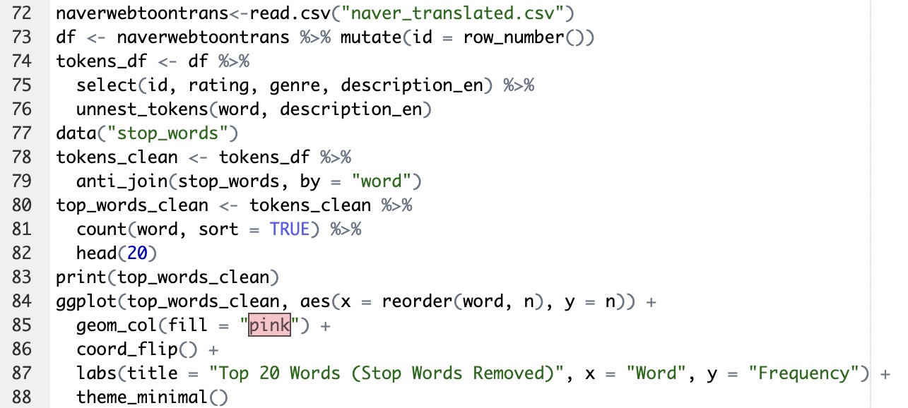
In the beginning I generated a graph that had just words that would obviously be used the most (the, and, a, etc.)
By using data(“stop_words”) and the anti_join() function, I separated these stop words from the other words in the description to get an accurate analysis

Slide 9
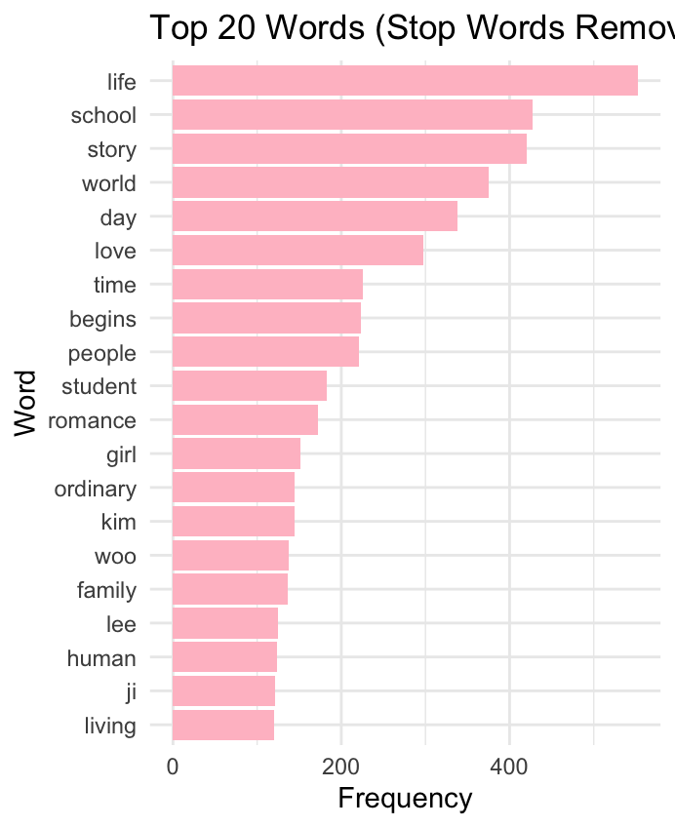
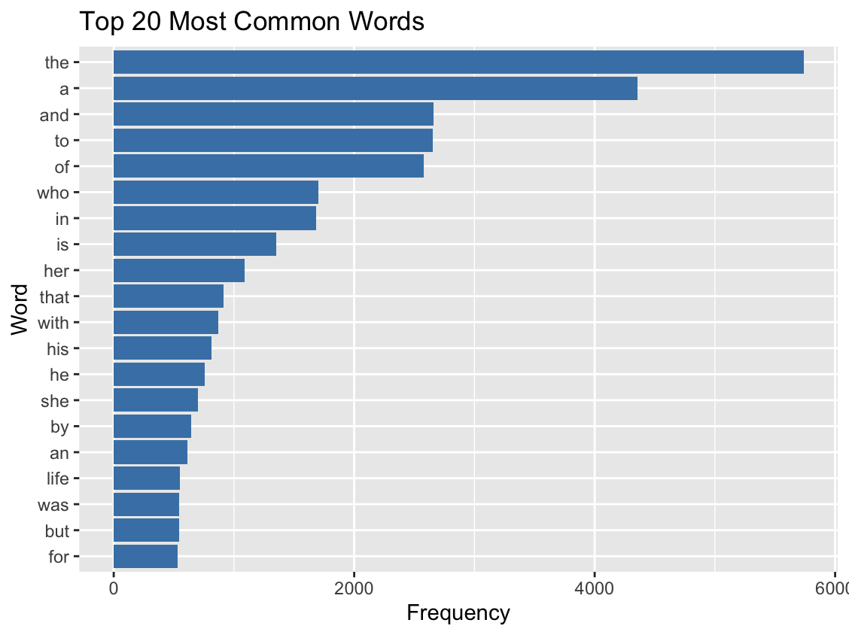
Before
After
Words “life”, “school”, ”story” are most commonly used in the descriptions of the webtoons
Authors tend to write stories that have a twist to everyday activities

Slide 10
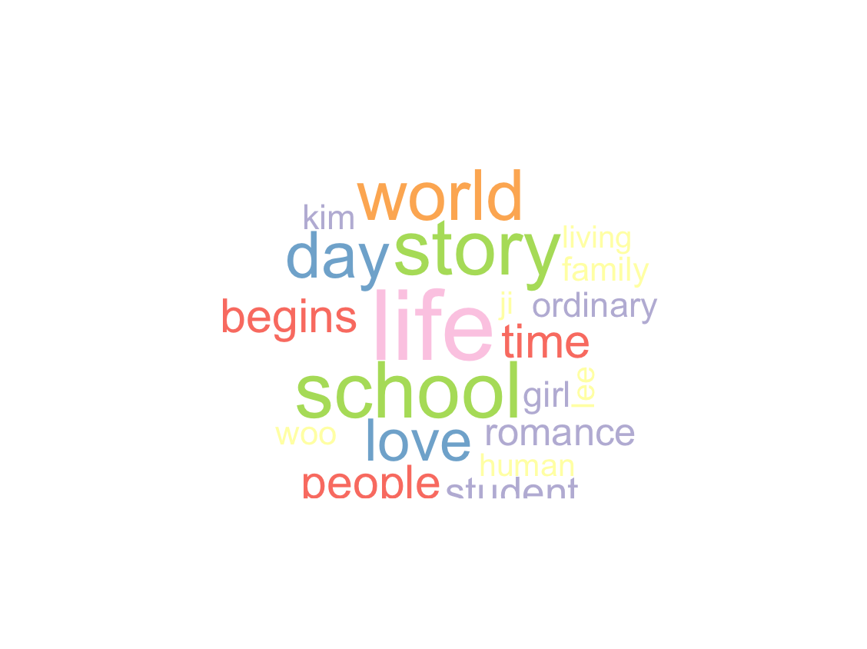
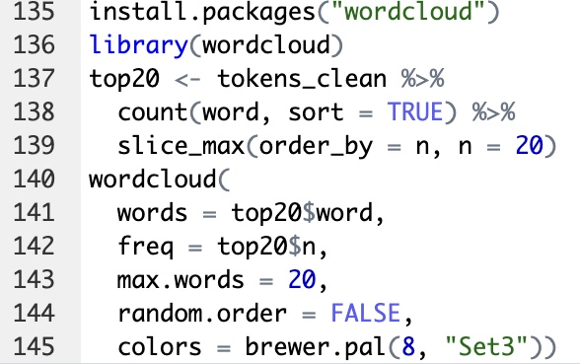
Also… Wordcloud

Slide 11
Third step: Genre/rating correlation
I wanted to find the correlation between the genre of the webtoons and what their rating was.
Since the genre columns (both in Korean and English) had a comma (__,__) I had to split them into separate observations, giving each webtoon 2 lines

Slide 12
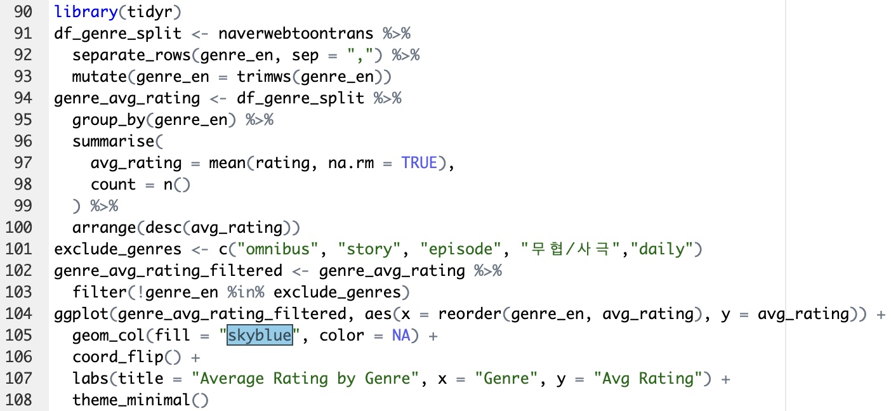
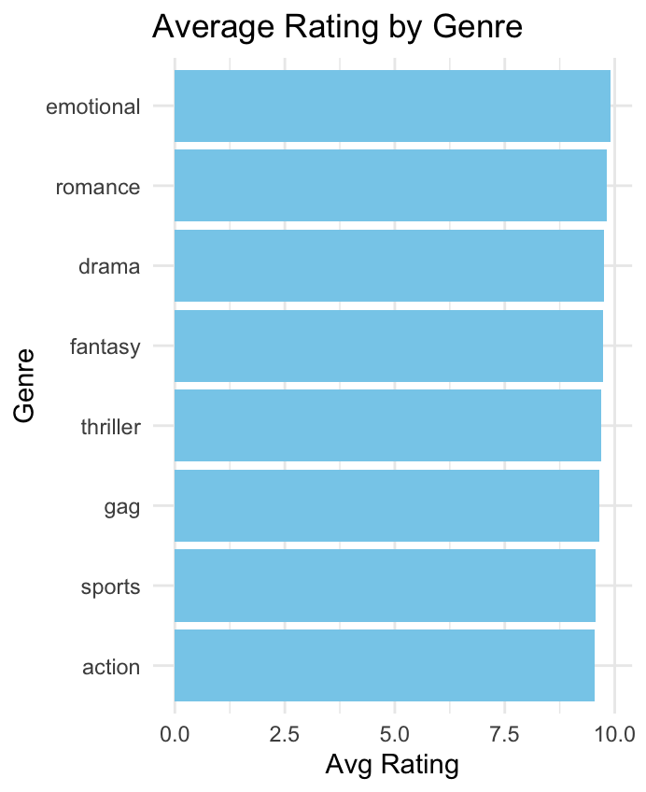
I was able to separate the unusable other half of the genre column which stated the type of upload each story was (story, omnibus, daily)
Even though the ratings are close, we can tell the emotional and romance genres are the highest rated, while action and sports aren’t as liked

Slide 13
Fourth step: Sentiment polarity analysis
I wanted to see whether the descriptions of the webtoons contained positive or negative phrasing coordinating with their genre.

Slide 14
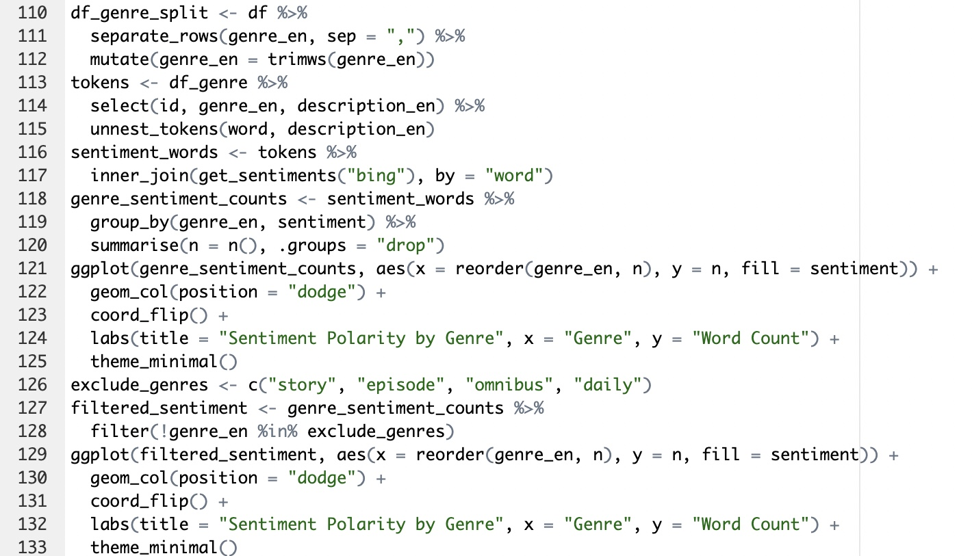
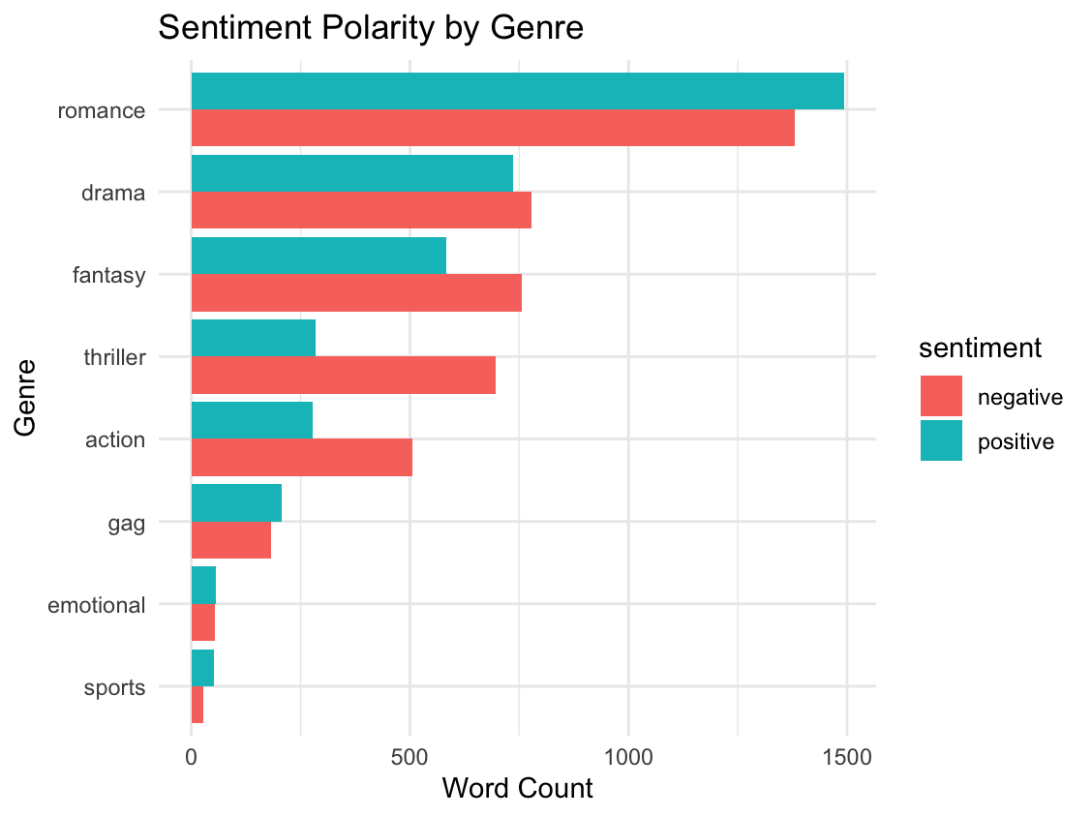
Romance, gag (comedy), and sports all have a more positive tone
Drama, fantasy, thriller, and action all have a more negative tone
The emotional genre seems to have a neutral tone

Slide 15
In conclusion
Webtoons that have a negative vibe associated with them are more common and widespread amongst genres, aside from romance that is more positive.
Romance and dramatic webtoons are highest rated on the app, while sports webtoons don’t do as well.
Webtoons with a twist on a regular lifestyle are commonly written.

Slide 16
Thank You!
Any questions?
I hope you enjoyed my presentation!
If you are interested in reading a webtoon, here are some of my favorites:
True Beauty (Romance, Comedy)
Weak Hero Class (Action, Thriller)
Lovely Runner (Romance, Comedy, Drama)

